Slide 1
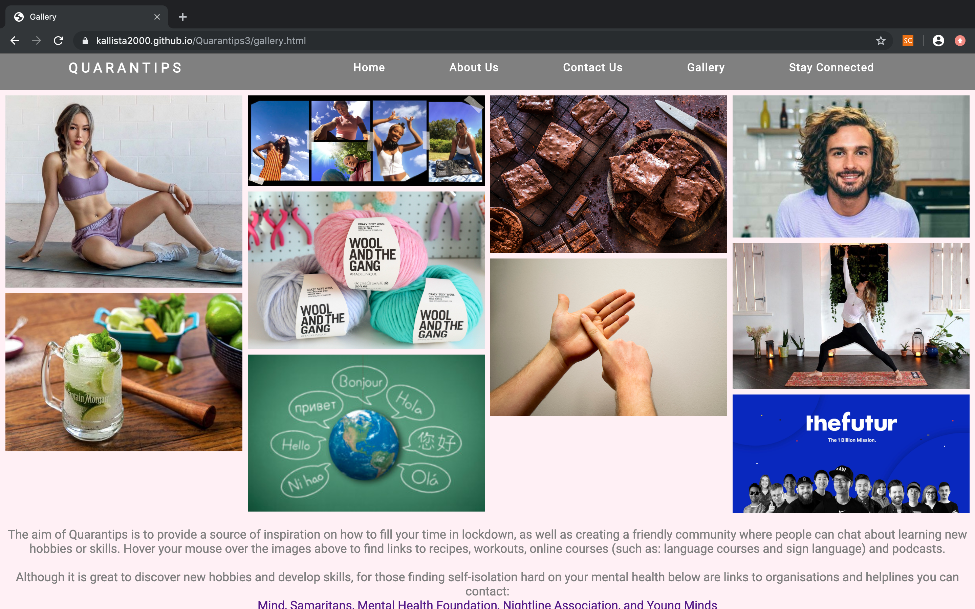
https://kallista2000.github.io/Quarantips3/gallery.html

Slide 2
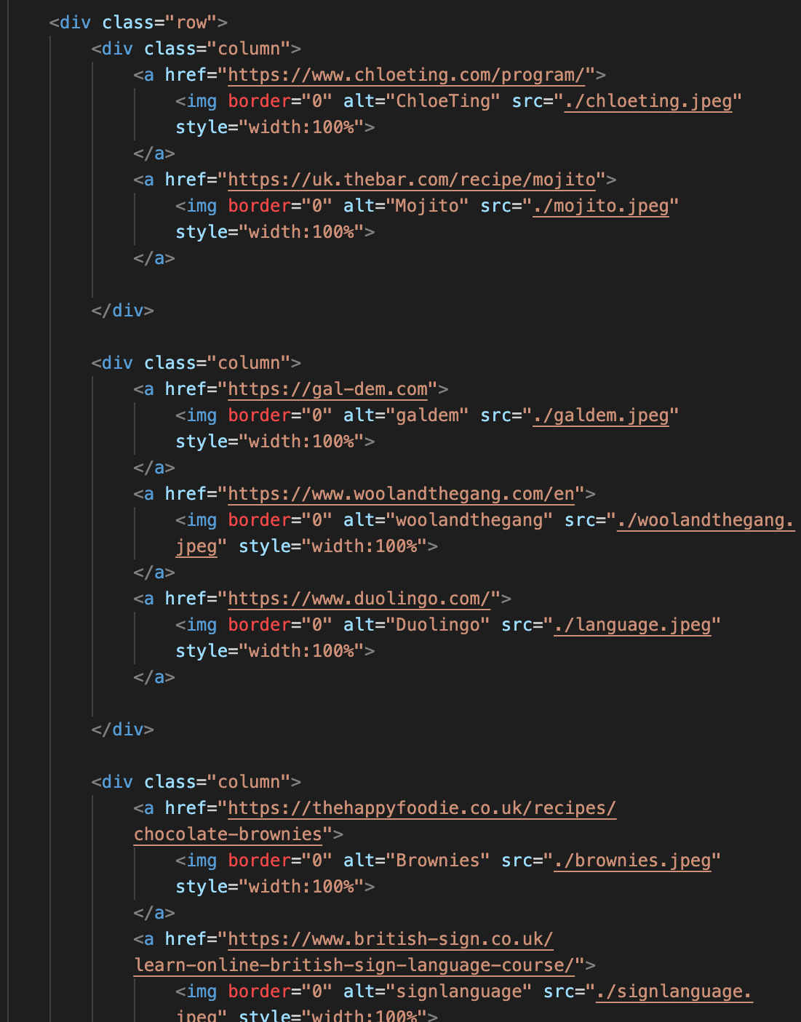
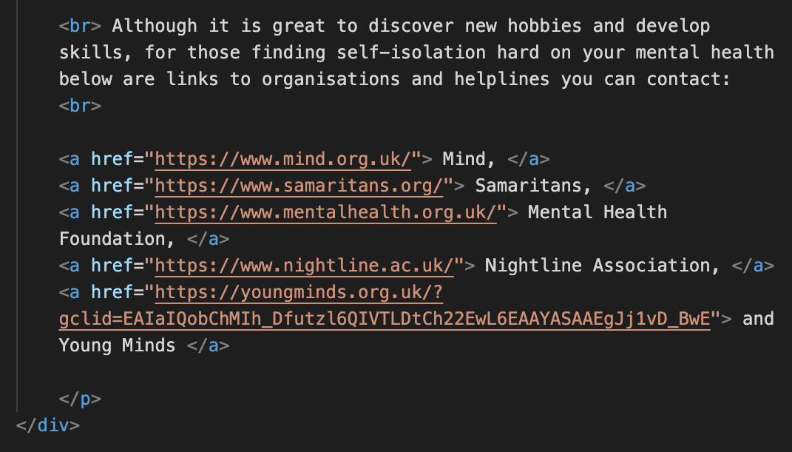
HTML code for gallery page:
Notes:
html

Slide 3
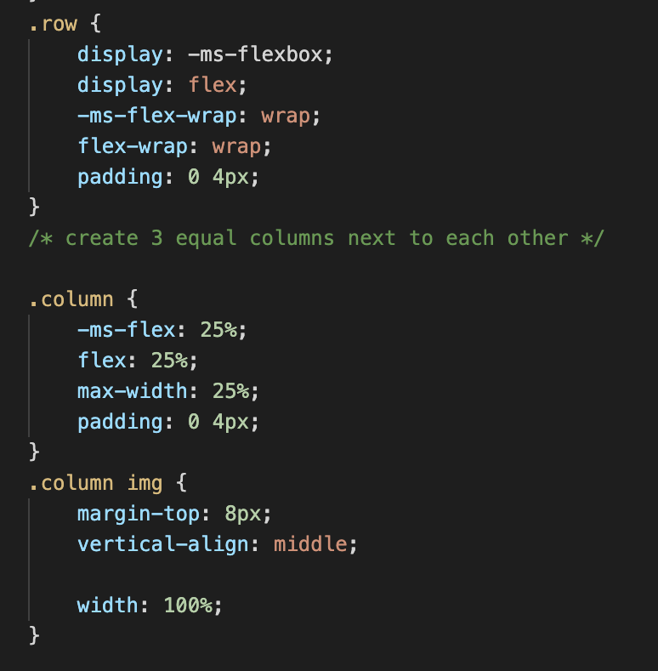
Notes:
css

Slide 4
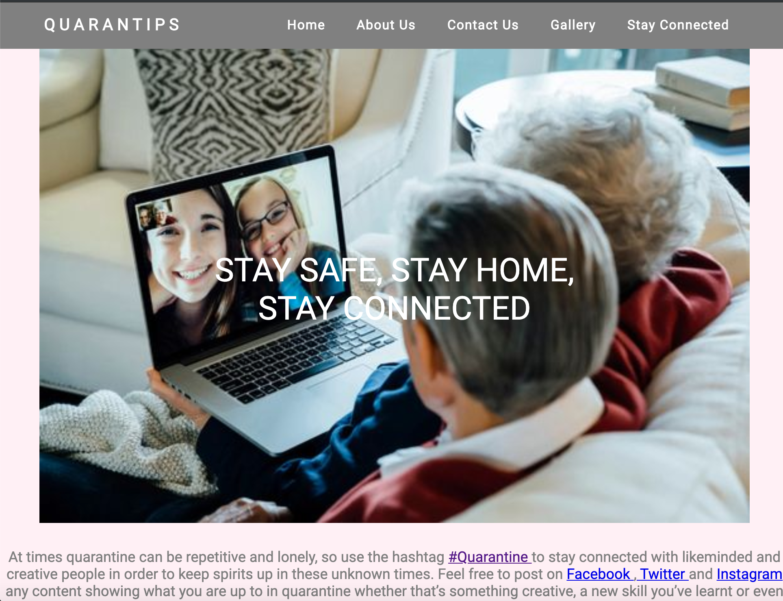
https://kallista2000.github.io/Quarantips3/contactus.html

Slide 5
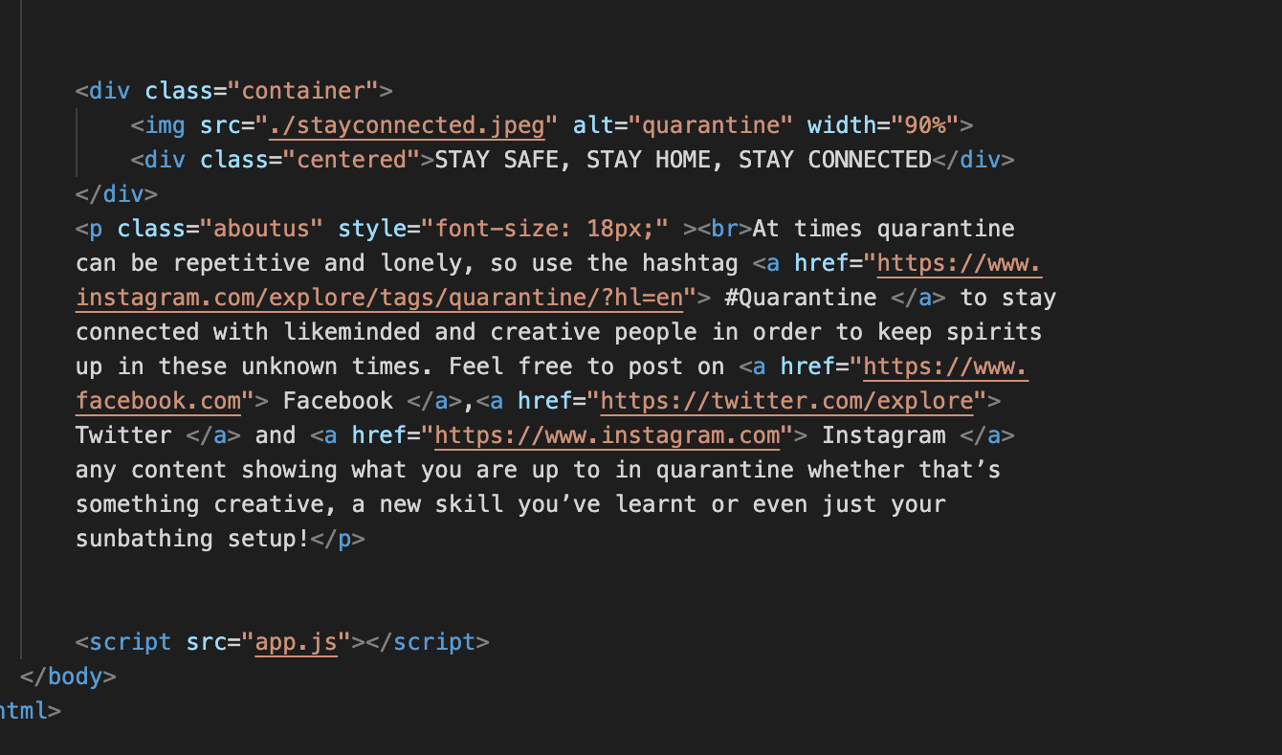
Notes:
html

Slide 6
